Slide 1
VeriCred
VC
Verified Trust for the Gig Economy
AI work-history scoring and a blockchain ledger for fair loan decisions on gig workers.
Team: CB.SC.U4CSE24730 · CB.SC.U4CSE24528
Notes:
Introduce the project in one sentence: VeriCred helps banks lend to gig workers who have steady income but no salary slip or credit history, by turning their work history into one verified score and recording each decision on a blockchain. Mention both team roll numbers.

Slide 2
Steady income. No paper trail.
THE PROBLEM
No salary slip
No credit history
No loan
Delivery and ride-hailing partners are paid per task, so banks have no payslip to read.
Many have never held a loan or card, so a CIBIL score is low or missing.
Reliable workers are rejected, even though the proof of their work already exists.
VeriCred · Verified Trust for the Gig Economy
Notes:
Walk through the three-step rejection: no payslip, no credit history, therefore no loan. The key line: the proof of reliable work exists, just not in a form banks check.

Slide 3
Turn work history into one verified score
OUR IDEA
1
2
3
Collect
Score
Verify
Ride and delivery records: ratings, cancellations, on-time rate, activity and payments.
Seven weighted signals give an AI Work-History Score, blended with CIBIL into a Risk Meter.
Every officer decision is hash-linked on a ledger, so any later change is visible.
VeriCred · Verified Trust for the Gig Economy
Notes:
Three steps: collect the work data, score it, verify and record it. Each step maps to a module in the project: scoring_engine, risk_engine, and the blockchain layer.

Slide 4
Seven signals, one score
AI WORK-HISTORY SCORE
Signal | Weight
Customer rating | 25%
Cancellations (reliability) | 20%
On-time completion | 20%
Activity consistency | 15%
Complaint-free rate | 10%
Digital payment use | 5%
Earnings stability | 5%
EXAMPLE
93.85
Arun Kumar Selvam: over 6,000 completed rides, a high rating and very few cancellations.
VeriCred · Verified Trust for the Gig Economy
Notes:
Rating carries the most weight at 25 percent, then cancellations and on-time rate at 20 each. Weights add up to 100. The score is a weighted sum scaled 0 to 100.

Slide 5
One number the officer can act on
RISK METER
55%
30%
15%
AI Work-History
CIBIL
The seven-signal score
Formal credit score
Balance
Bank balance adequacy
75 and above: Low Risk
50 to 74: Moderate Risk
Below 50: High Risk
VeriCred · Verified Trust for the Gig Economy
Notes:
The Risk Meter blends three inputs: 55 percent AI score, 30 percent CIBIL, 15 percent bank balance adequacy. Higher means safer. Bands: 75 and above Low, 50 to 74 Moderate, below 50 High.

Slide 6

Five layers, one direction of flow
SYSTEM ARCHITECTURE
Ride data
Scoring
Risk engine
Officer portal
Blockchain
CSV work history per worker
Seven signals to AI score
AI + CIBIL + balance
Flask web app
Ledger on Polygon Amoy
Raw ride data stays off-chain. Only a fingerprint of it, with the decision, is written to the blockchain.
VeriCred · Verified Trust for the Gig Economy
Notes:
Follow the arrows left to right. Scoring and risk are in Python; the portal is Flask; the last layer is the hash-chained ledger and the Solidity contract. Privacy point: raw data never goes on-chain.

Slide 7
Decisions nobody can quietly change
BLOCKCHAIN LAYER
Hash chain
Merkle root
Signed records
Each block stores the SHA-256 hash of the one before it. Change one record and every later link breaks.
One root hash proves a whole dataset is untouched. Only the root goes on-chain, never the raw data.
Every record carries an oracle signature, and only the oracle wallet may write to the contract.
Tamper test: we altered one value in a past record, and the chain check flagged it as invalid straight away.
VeriCred · Verified Trust for the Gig Economy
Notes:
Explain the three protections in plain words. Hash chain: links blocks. Merkle root: fingerprint of the dataset. Signature: only the authorised oracle can record. Mention the tamper test result from the report.

Slide 8
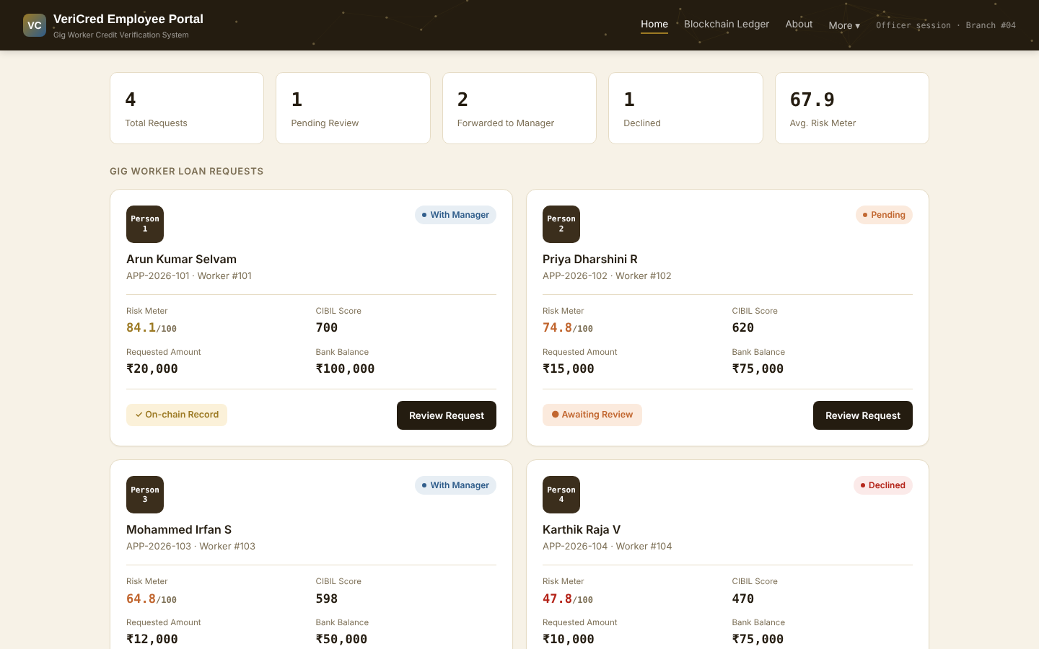
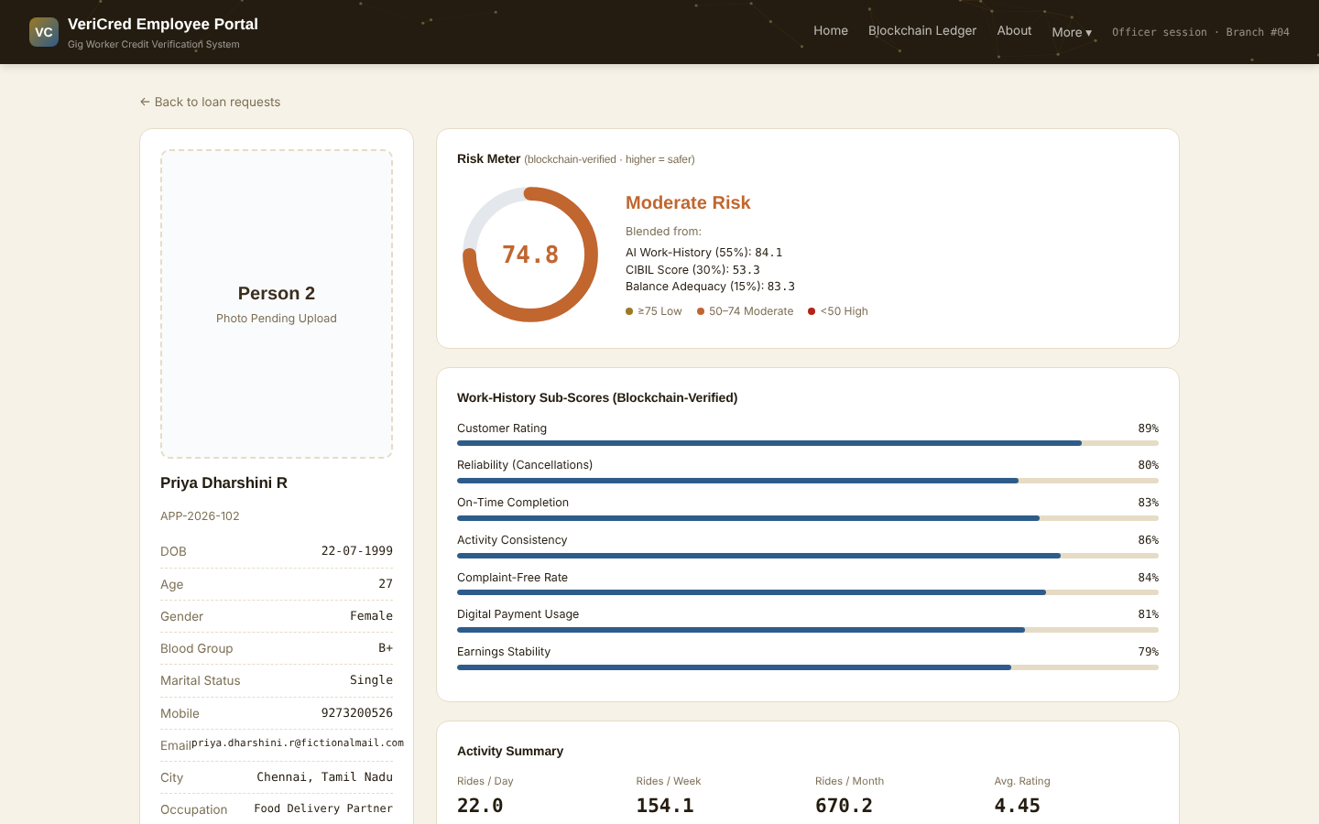
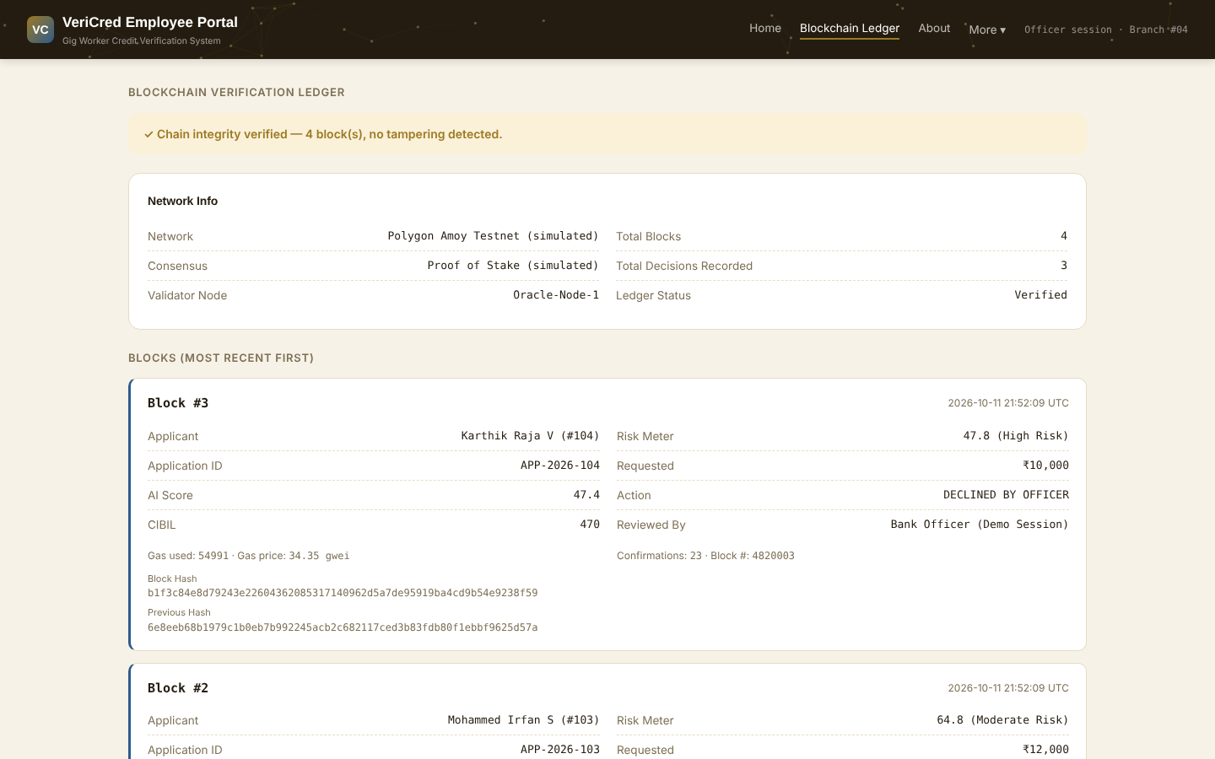
What the bank officer sees
THE WORKING PORTAL
Dashboard of loan requests
Risk Meter and seven sub-scores
Hash-linked ledger with integrity check
The officer reviews an applicant, then forwards the request to the Bank Manager or declines it. Each decision is written to the ledger.
VeriCred · Verified Trust for the Gig Economy
Notes:
Live demo point. The portal runs in a simulated mode with a local ledger, or in real mode where the decision is sent to the contract on Polygon Amoy. Say which mode you are showing.

Slide 9
The scores separate reliable from risky
RESULTS
Applicant | AI score | CIBIL | Risk Meter | Band
Arun Kumar Selvam | 93.85 | 700 | 84.1 | Low Risk
Priya Dharshini R | 84.14 | 620 | 74.8 | Moderate Risk
Mohammed Irfan S | 68.74 | 598 | 64.8 | Moderate Risk
Karthik Raja V | 47.40 | 470 | 47.8 | High Risk
Four synthetic applicants, one per performance tier. The ranking follows work history: more completed rides, higher ratings and fewer cancellations give a safer score.
VeriCred · Verified Trust for the Gig Economy
Notes:
Point out that the order of AI scores matches the order of Risk Meter values. The test data is synthetic. Priya is Moderate because her CIBIL of 620 pulls the blend down below 75.

Slide 10
GigWorkerLoanLedger
SMART CONTRACT
struct DecisionInput
Network: Polygon Amoy testnet (chain ID 80002)
workerId, applicationId
applicantName
aiScoreScaled (x100)
cibilScore
riskMeterScaled (x100)
riskBand, requestedAmountInr
merkleRoot (bytes32)
action, reviewedBy
Language: Solidity 0.8.20
Write access: only the authorised oracle wallet
Scores: stored as whole numbers, 93.85 becomes 9385
Functions: recordDecision, getLatestDecision, verifyLatestMerkleRoot
VeriCred · Verified Trust for the Gig Economy
Notes:
Solidity has no decimals, so scores are multiplied by 100. The modifier onlyOracle rejects any other wallet. verifyLatestMerkleRoot lets anyone check a dataset fingerprint against what was recorded.

Slide 11
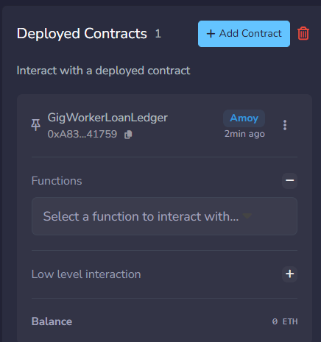
Deployed on Polygon Amoy
LIVE DEPLOYMENT
Deployed from Remix IDE through MetaMask to a live public test network.
Source verified on Sourcify, so anyone can read the code.
Connected from our Python code through an Alchemy node, reading live blocks.
Cost: one recorded decision uses about 413,000 gas, measured in testing.
0xA835471327167F662686D0f0a6146c94e1041759
VeriCred · Verified Trust for the Gig Economy
Notes:
Be precise: this is a testnet deployment, not mainnet, so the coins have no real value. The address can be searched on amoy.polygonscan.com. If you also recorded a decision live, show that transaction page here.

Slide 12
From prototype to real lending
FUTURE SCOPE
Real platform data
Learned model
Audit and mainnet
Worker app
Train on repayment outcomes instead of fixed weights.
Let workers see and share their own verified score.
Connect to gig platforms with the worker’s consent.
Security review of the contract before any production use.
VeriCred · Verified Trust for the Gig Economy
Notes:
Be honest that the data is synthetic and the weights are hand-set. These four steps are what would turn the prototype into something a bank could pilot.

Slide 13
Thank you
Questions?
Built with Python, Flask, Solidity, Web3.py, JavaScript and Chart.js. Deployed on Polygon Amoy.
VeriCred · Verified Trust for the Gig Economy · CB.SC.U4CSE24730 · CB.SC.U4CSE24528
Notes:
Close with the one-line summary: reliable gig workers get a fair, verifiable score, and every decision is recorded where it cannot be quietly changed. Then take questions.

